Slide 1
National Institute of Technology, Warangal
Department of Electronics and Communication Engineering
Cloud Computing Project
Serverless Static Website on AWS
(Research Project Blog)
VENKATNARAYAN GNANAGURUPARAN
Roll Number: 174266
Reg Number: 831777
Section: B

Slide 2
Deploy a Serverless website using AWS services.
link https://fakefacedetection.ml
Problem Statement
Objective

Slide 3
Cloud Hosting
Cloud hosting enables applications and websites accessible using cloud resources.
It is different from traditional hosting, where the applications and websites are deployed on a single server.
Cloud hosting has a network of connected virtual and physical cloud servers that hosts the application or website, ensuring greater flexibility and scalability.
Cloud Servers
Cloud Servers can be created in seconds, easily scaled up, and deleted at ease. The services are charged only for the Cloud Server utilization.
This allows users to maintain and configure their set-up without having to request outside help each time minor changes or upgrades if needed.

Slide 4
Static Websites
A Static website reduces complexities and focuses on improving efficiency and performance.
It does not rely on databases. It mostly involves basic HTML, JavaScript, and CSS to produce light websites.
These websites have no back-end systems, client-server requests, or database queries which allows these sites to have a faster performance.
Static websites provide more security than a dynamic website as they do not have any database to exploit.
Serverless Architectures
Serverless architectures usually have access points on a global scale.
They can handle users from every corner of the world using appropriate load balancers and distribution networks.

Slide 5
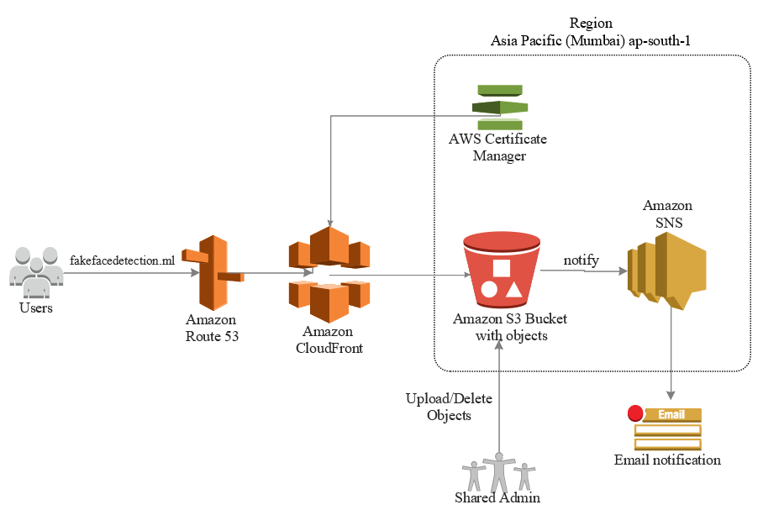
Architecture
AWS Services Utilized
•Route 53
•CloudFront
•S3 (Simple Storage Service)
•ACM (AWS Certificate Manager)
•SNS (Simple Notification Service)

Slide 6
Pipeline
User - Website
User accesses the “fakefacedetection.ml” website by typing the domain name.
Route 53 will route the user to CloudFront which is a content delivery network service.
CloudFront retrieves the content from the S3 bucket and distributes it.
ACM provides the SSL certification for the website to CloudFront.
The Website content is accessible to the User.
Admin/Developer - Website
Any update or Deletion of objects in S3 bucket by the admin/developers.
S3 triggers the SNS about update of objects in bucket.
SNS sends an E-Mail to the admin regarding the update and deletion of Objects in S3.

Slide 7

Route 53
Amazon Route 53 is a highly available and scalable cloud Domain Name System (DNS) web service.
It effectively connects user requests to infrastructure running in AWS.
The Domain name (“fakefacedetection.ml”) was registered with Freenom.
In this Architecture, Route 53 was utilized to connect the Users with CloudFront.
Route 53 was configured by creating a Hosted zone for DNS management with a suitable domain name.
Route 53 was configured

Slide 8
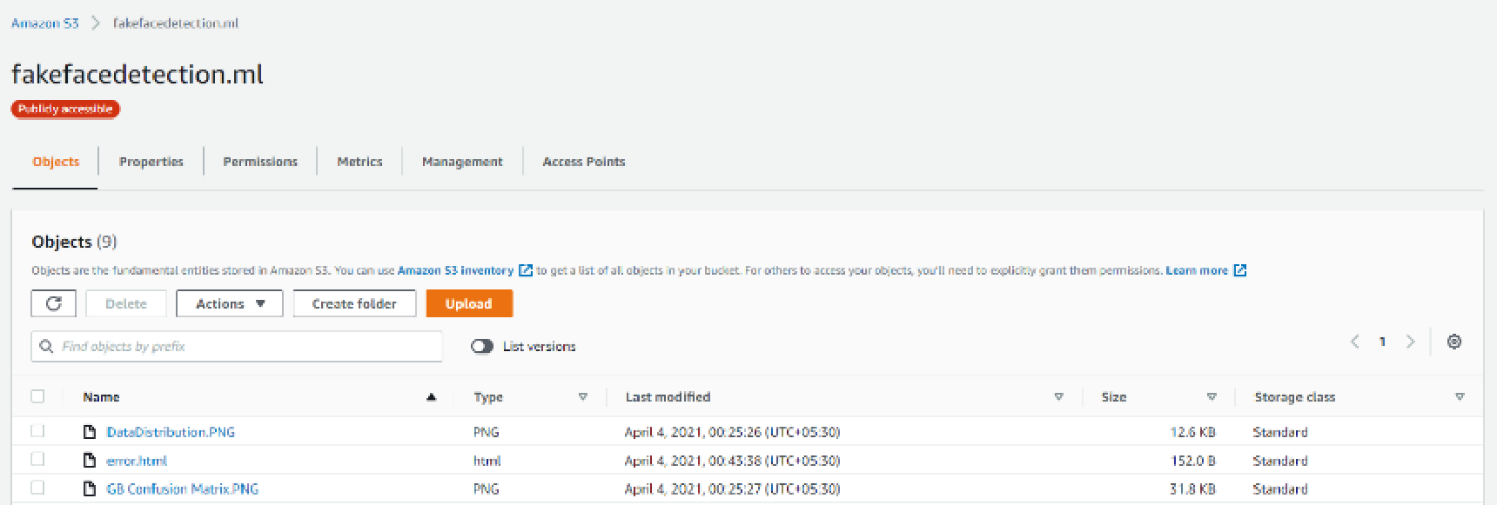
S3 (Simple Storage Service)
S3 was used in this architecture to host the static HTML website with index document support and error document support.
“index.html” was the default page that was displayed and “error.html” was used to display in the event of a partially invalid URL.
All the objects necessary for the static website were uploaded on S3.
S3 was configured and contents for the website were uploaded

Slide 9
AWS Certificate Manager
This service allows developers to provision, manage, and deploy public and private Secure Sockets Layer/Transport Layer Security (SSL/TLS) certificates for use with AWS services and internal connected resources.
SSL protects website from phishing scams, data breaches, and many other threats. It builds a secure environment for both visitors and site developers.
In this architecture AWS Certificate Manager was used to request a certificate, deploy it on ACM-integrated Amazon CloudFront distribution.
SSL certificate for the registered domain is obtained from ACM Certificate and a record is created in Route 53.
ACM Validation record created in Route 53

Slide 10
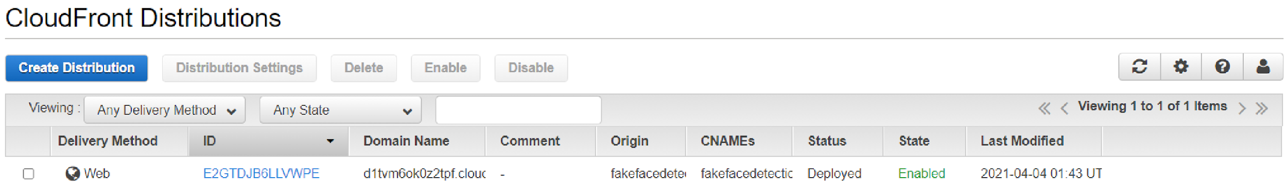
CloudFront
CloudFront is a content delivery network (CDN) service that securely delivers data to users globally with low latency, high transfer speeds by caching the websites.
CloudFront was used as it works seamlessly with S3 or with any custom HTTP origin.
Created a CloudFront distribution and configured it with custom certificate from ACM, URL of the S3 bucket that holds the contents of the website and Route 53 with the domain name.
Configured CloudFront Distribution

Slide 11
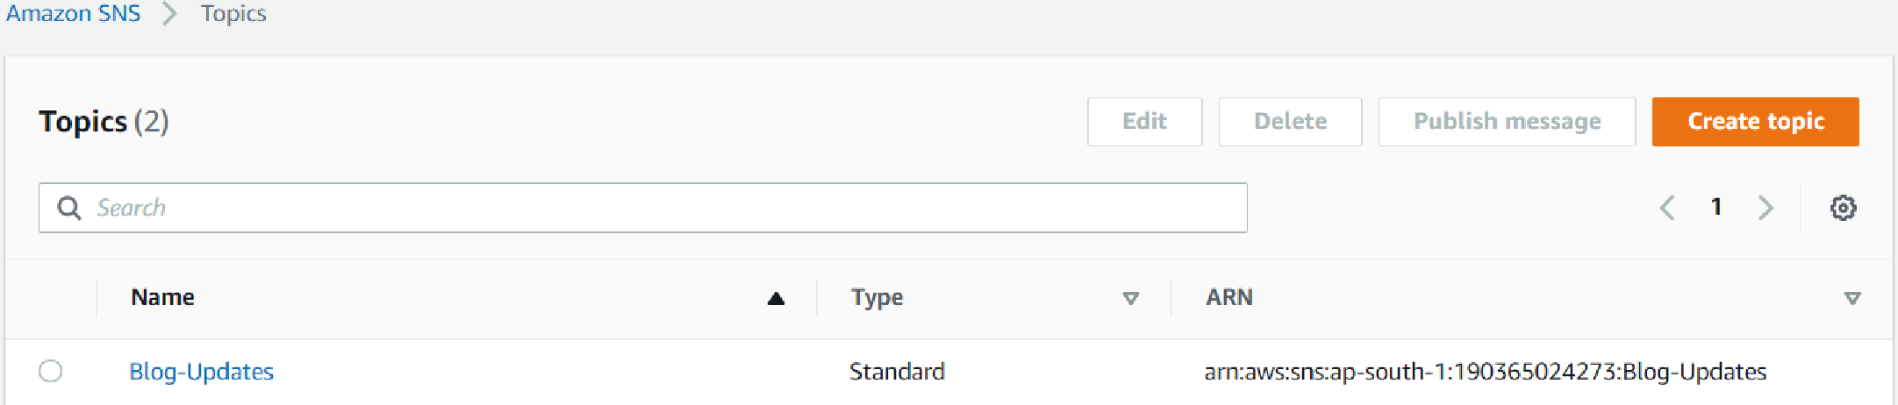

SNS (Simple Notification Service)
It is a fully managed messaging service for both application-to-application (A2A) and application-to-person (A2P) communication.
It notifies the admin through E-Mail if any object was uploaded or deleted from the S3 bucket.
Create a SNS Topic and subscribe to the SNS Topic with the admin’s E-Mail id as the endpoint, select the notifications for events that are necessary.
Configured SNS
E-Mails from SNS

Slide 12
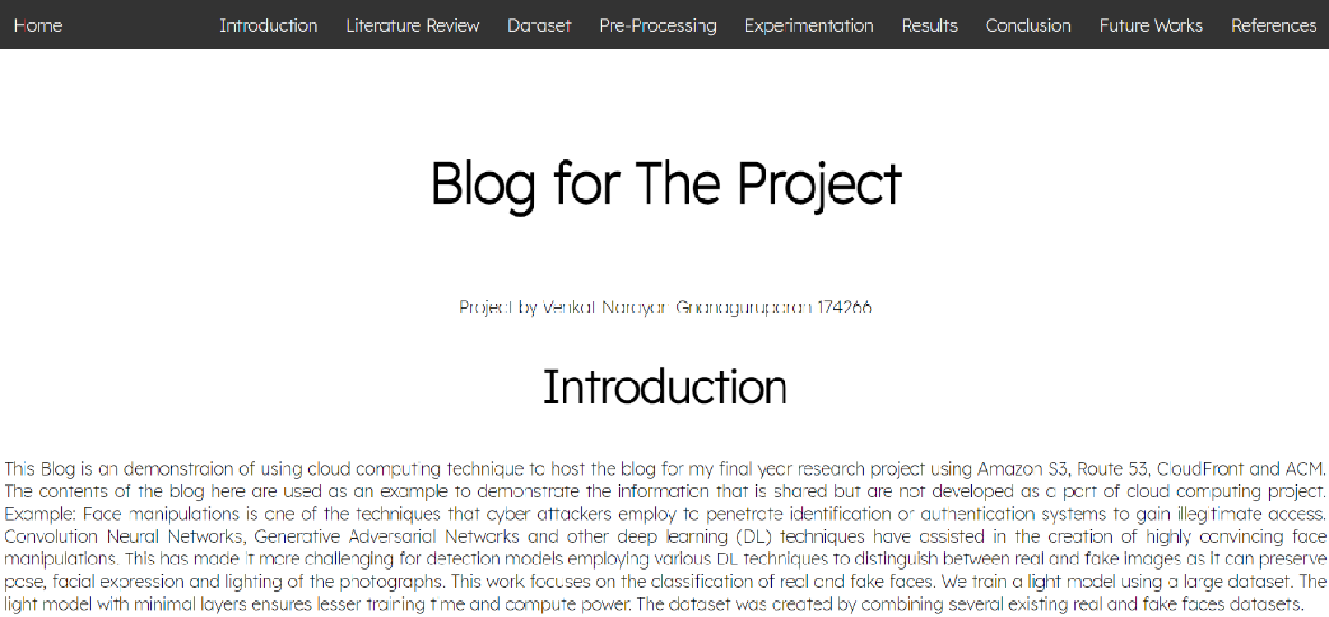
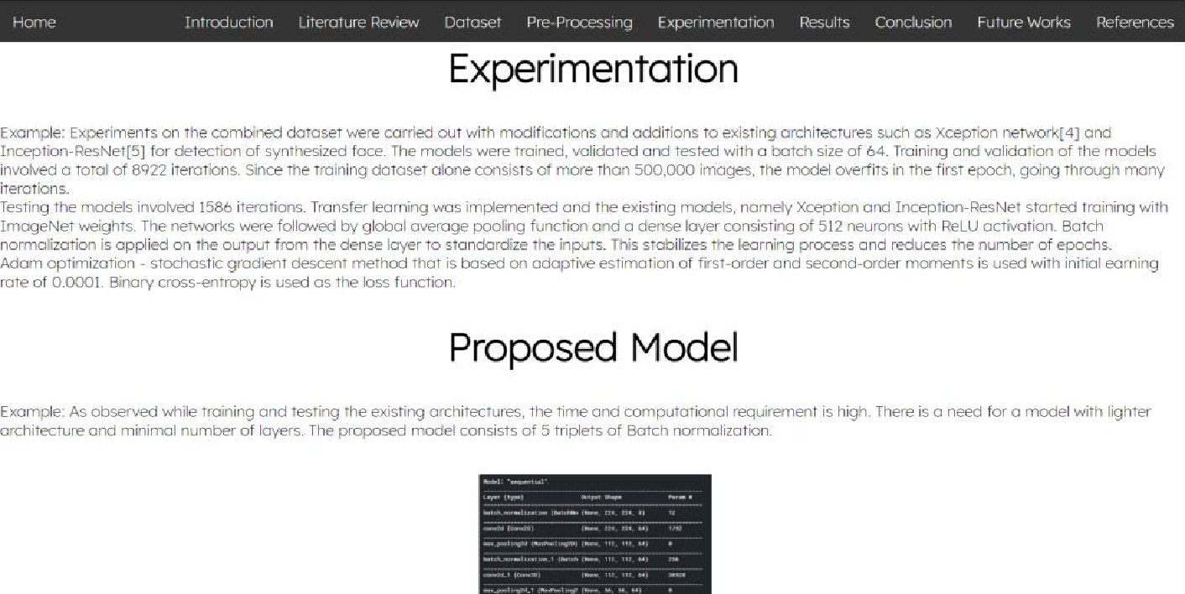
Website
The website was developed using HTML and CSS.
It has improved performance for end users compared to sites with multiple pages. Cost of these websites is less as it only utilizes cloud storage, as opposed to a hosted environment.
This website has a single page design which contributes to an intuitive user journey. With no additional pages, users have a linear navigation flow – which provides information about the project.
Studies show that having a single page can lead to increased conversions than multi-page sites because users begin the process sooner and move through it more quickly, with nowhere to get distracted by another offer.
Having a straightforward navigation design is that there is usually only one action to be taken by the user.

Slide 13
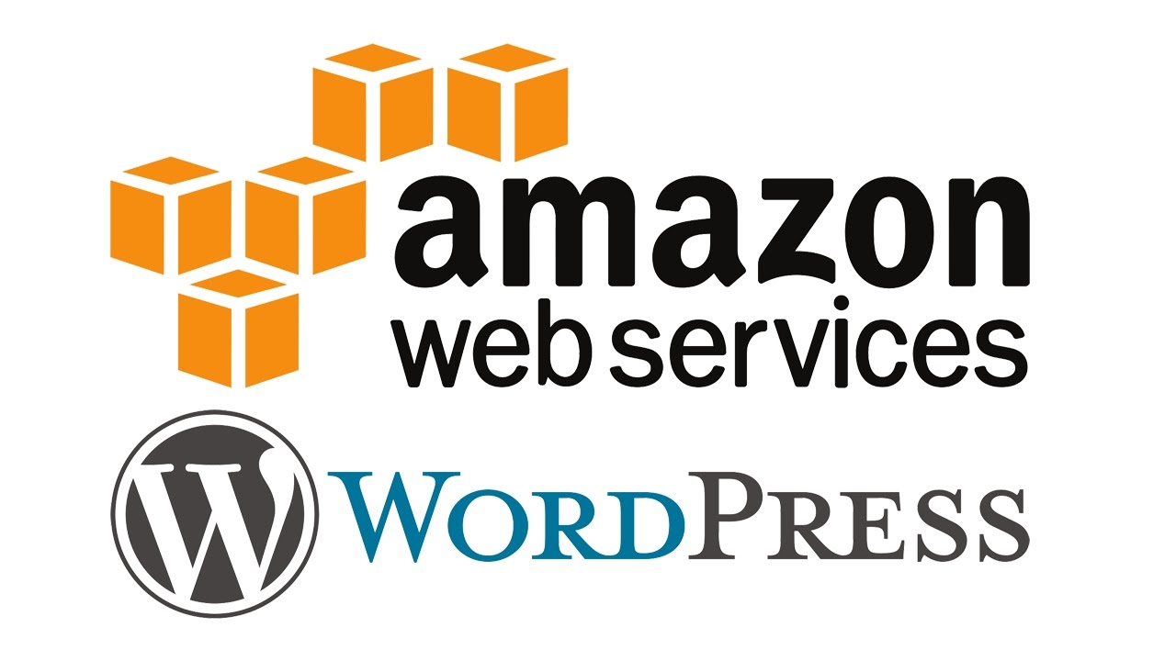
Alternative Methods for Static Web Hosting
WordPress, Amazon EC2 and S3
WordPress is a popular content management system due to its simplicity and is considered an inexpensive way for businesses to get started online.
WordPress can be slow at times due to the added plugins, overfully managed hosting for static websites and web apps. Amplify hosting solution uses saturated codebases and other features that can slow down the website.
For static websites, the cost is reduced by using CloudFront and S3 rather than EC2 which charges on the hours it runs. EC2 instances need to keep running to deliver content for static website.
On S3, there is no risk of over-provisioning and hence, no need to manage disk utilization.

Slide 14

Alternative Methods for Static Web Hosting
AWS Amplify
AWS Amplify provides fully managed hosting for static websites and web apps. Amplify hosting solution uses CloudFront and S3 to deliver the site contents via the AWS content delivery network (CDN).
It requires knowledge of APIs and shell scripting.
However, if any objects in the S3 were created or deleted, it wouldn’t notify the admin as it lacks SNS feature and these websites don’t have the SSL certification from ACM.

Slide 15

Alternative Methods for Static Web Hosting
Amazon LightSail
Amazon LightSail offers more than 10 images with ready to run popular software.
The image with the pre-installed Nginx web server, PHP, and MySQL could be used to host a static website on Amazon LightSail.
However, this would require a server even for a static website unlike the architecture developed in this project.

Slide 16


Alternative Methods for Static Web Hosting
Google Cloud Storage and Cloud Load Balancing
The hosting environment in the Google cloud is optimized for high-end WordPress and WooCommerce based websites. Its price starts from 25$/month.
Support fee is quite hefty, around 150 USD per month for the most basic service.
Amazon S3is more durable than cloud storage.

Slide 17
Alternative Methods for Static Web Hosting
Other Services
Netlify, Surge, Render, GitHub Pages, Firebase and Cloudflare offer web hosting services which are user friendly but are not flexible with architecture.
The architecture is abstracted in such services and there is a need for additional support and services from providers increasing the cost for hosting a static website.
It would be relatively expensive and unjustifiable to host a single one page website on these services.

Slide 18
Conclusion
A Serverless static website was deployed with HTTPS on cloud with a suitable architecture, using services offered by AWS i.e. Route 53, CloudFront, S3 (Simple Storage Service), ACM (AWS Certificate Manager) and SNS (Simple Notification Service).
Serverless static website that was created for the research project can be accessed using the link https://fakefacedetection.ml

Slide 19
References
• CloudFront Using Amazon S3 Buckets for Your Origin
https://docs.aws.amazon.com/AmazonCloudFront/latest/DeveloperGuide/DownloadDistS3AndCustomOrigins.html#concept_S3Origin
• S3 Website Hosting
https://docs.aws.amazon.com/AmazonS3/latest/userguide/WebsiteHosting.html
• S3 Website Endpoints
https://docs.aws.amazon.com/AmazonS3/latest/userguide/WebsiteEndpoints.html
• SNS Configuration
https://docs.aws.amazon.com/sns/latest/dg/sns-configuring.html
• ACM for Certificate
https://docs.aws.amazon.com/acm/latest/userguide/setup.html
• Configuring Amazon Route 53 as your DNS service
https://docs.aws.amazon.com/Route53/latest/DeveloperGuide/dns-configuring.html
• Amazon S3 vs. Google Cloud Storage vs. Azure pricing, features
https://searchstorage.techtarget.com/feature/AWS-vs-Azure-vs-Google-pricing-and-features-compared
• Hosting a static website | Cloud Storage | Google Cloud https://cloud.google.com/storage/docs/hosting-static-website
• Hosting a Static Website on an Amazon LightSail Instance
https://cloudbriefly.com/post/hosting-a-static-website-on-amazon-lightsail/
• Building a static serverless website using S3 and CloudFront https://sanderknape.com/2020/02/building-a-static-serverless-website-using-s3-cloudfront/

Slide 20
Thank You!
VENKATNARAYAN GNANAGURUPARAN
Roll Number: 174266
Reg Number: 831777
Section: B

